Slide 1
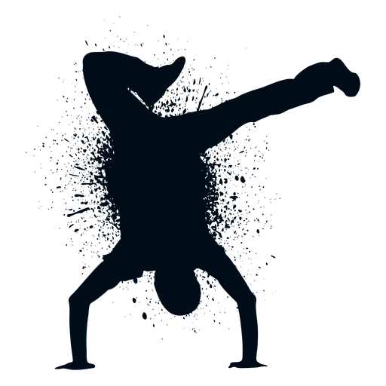
Grace Clark
Name
Instructor
Ziqian Zhou
DCE 100 Creative Project
2/21/21

Slide 2
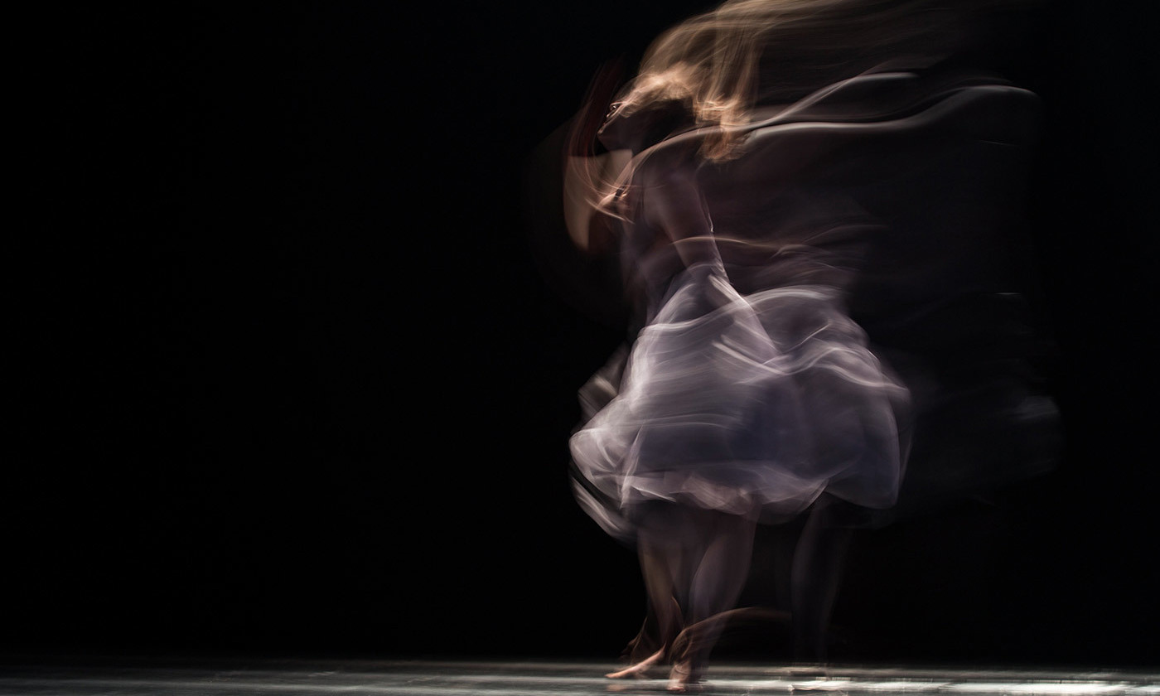
Meanings of Dance
I chose to focus on the meaning of dance. I chose this objective because as I have danced throughout my life, I have come to know many personal meanings of dance as well as learned other personal meanings outside of my own. The importance of dance has made become prevalent around the world and holds meaning to anyone, no matter skill level, which makes elaborating on it not just important for me, but important for others to see a new interpretation.

Slide 3
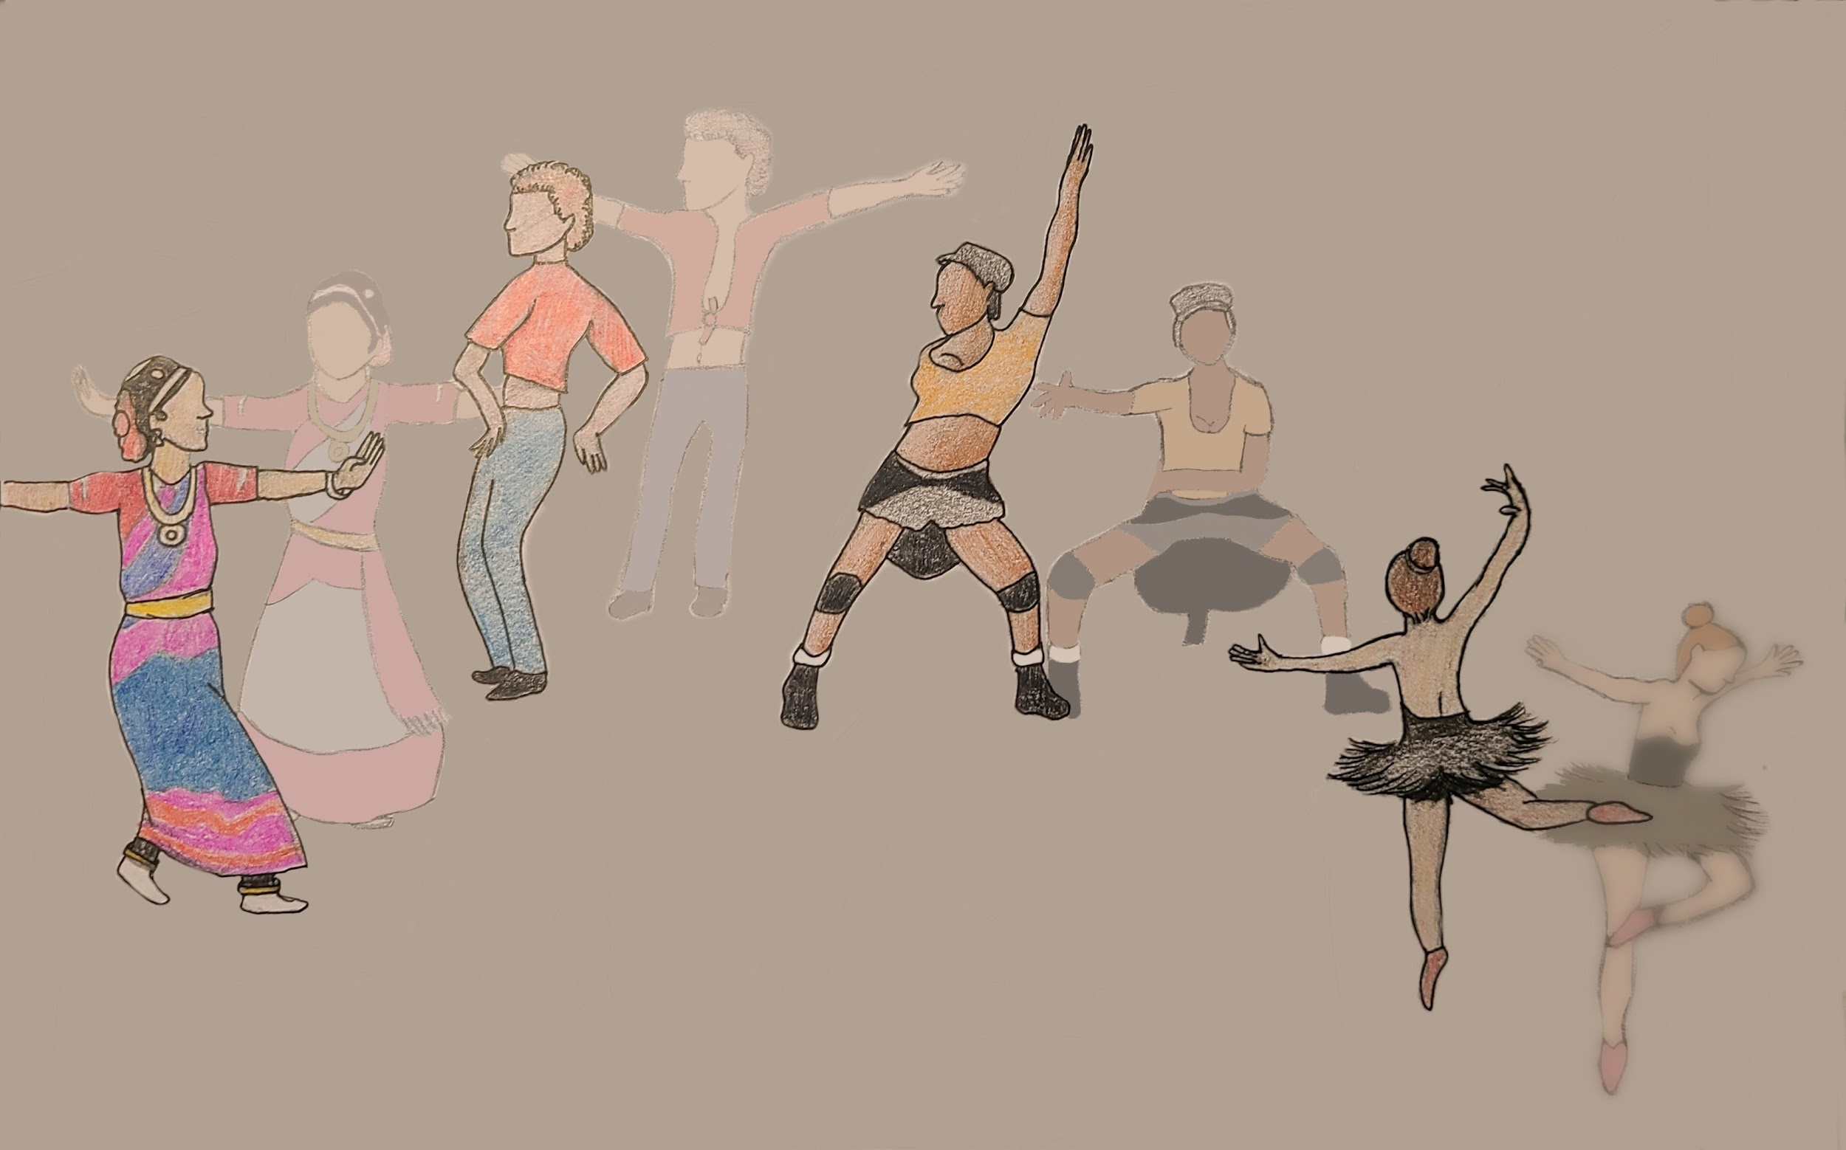
My Own Meaning of Dance
It’s as though all these different dances connect us to each other and bring us to learn more about ourselves and others, such is represented through this transition.
Construct a diagram of your own meaning of dance. Draw it using word drawing tools or freehand (take a picture of your diagram) and then put it on a slide.

Slide 4
List the meanings of dance that you identify in different contexts showing leadership or humanitarian values from the media you have seen.
With Religious Connections, participants are on the same page as to why they perform such a visual connection to their beliefs.
Religious Connection
With Cultural Connections, everyone has the responsibility to learn their own cultural traditions and fulfill them in their own way.
Cultural Connection
With Physical Connections, each person is their own leader in terms of their own part of the dance, in order to work together as a group.
Physical Connection
With Emotional Connections, it brings you closer to your individual understanding of yourself, whether it be mentally or physically.
Emotional Connection

Slide 5
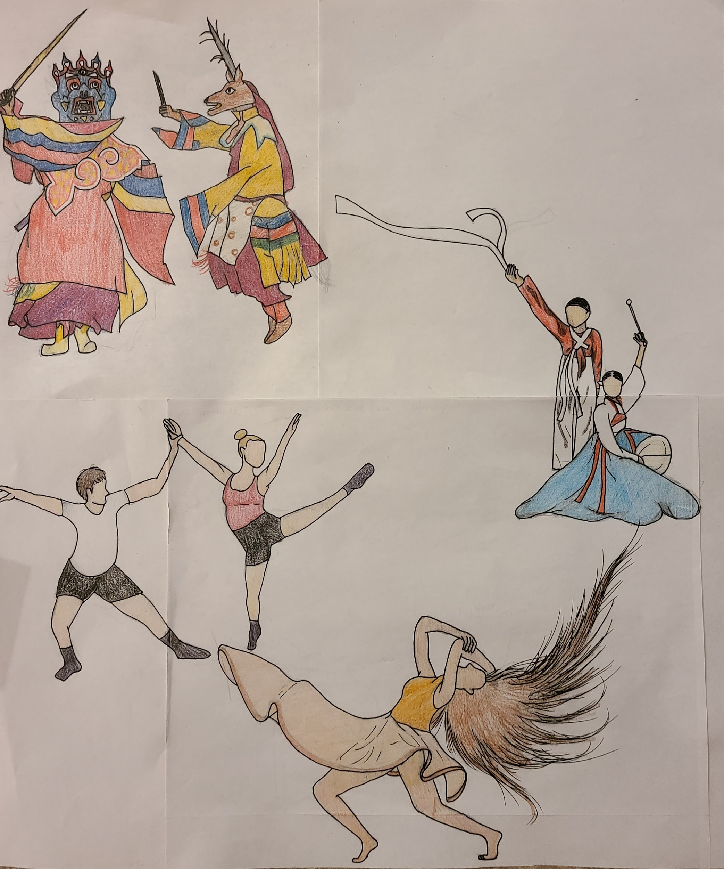
Religious Connection
The bottom starts with the
meaning of dance emotionally. Starting there is what draws most people to dancing, to release or embrace the feelings they have. It then extends to the meaning of dancing with others.. Using each other allows for more possibilities
to draw out the original feeling and goal. Also attached to the emotional connection is the cultural meaning. This is very important to people around the globe and is done to have a sense of belonging and to show others the wonders and traditions behind it. Following cultural connections is the religious meaning. They dance to please the ones they look to and to also please themselves in the process, making them happy and full of relief.
Cultural Connection
People Connection
Emotional Connection
Differentiate the meanings of dance you have learned in this class using a graph or some other visual design.

